Slide 1





Sentiment Analysis: Customer Support On X
(Formerly Twitter)
Camilo Durango
camilodurangos@gmail.com
LinkedIn GitHub

Slide 2

Leveraging NLP & ML for
Customer Satisfaction Improvement
Business Challenge:
Managing customer satisfaction at scale for popular brands.
Objective:
To build and compare different machine learning models for sentiment classification.
To identify the most accurate model for deployment in real-world scenarios.

Slide 3


Data Acquisition & Wrangling
PostgreSQL Database Solution
Dataset Overview
2.7 Millions of records of unprocessed tweets with 7 columns

Slide 4
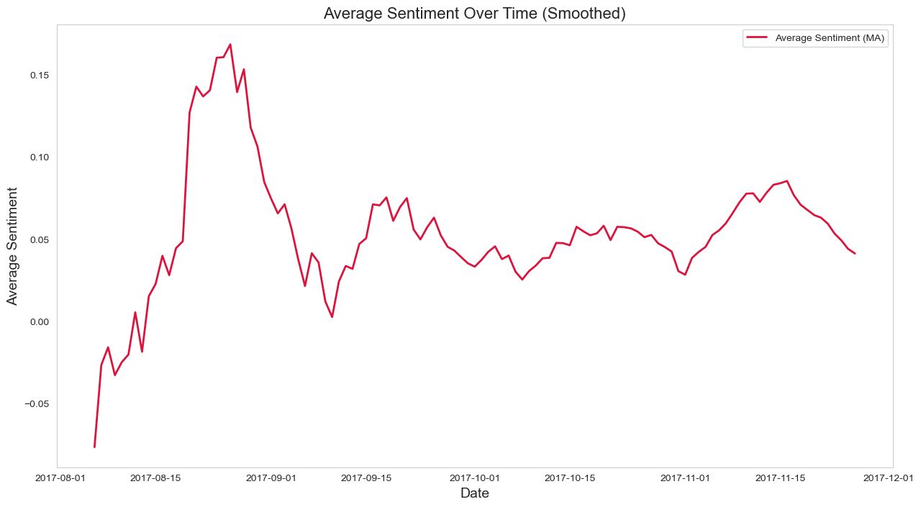
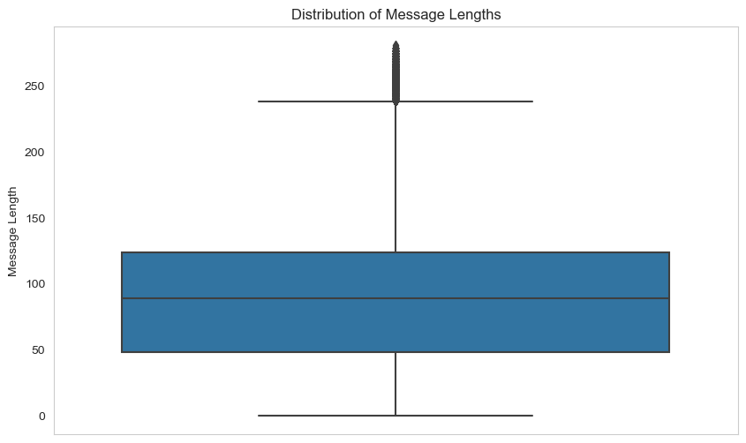
Exploratory Data Analysis
Distribution of Sentiment Scores | Sentiment Over Time | Common Words

Slide 5


Data Preprocessing
Tokenization
Lemmatization
TD-IDF Features
Feature Engineering
Combined Sparse Matrix

Slide 6

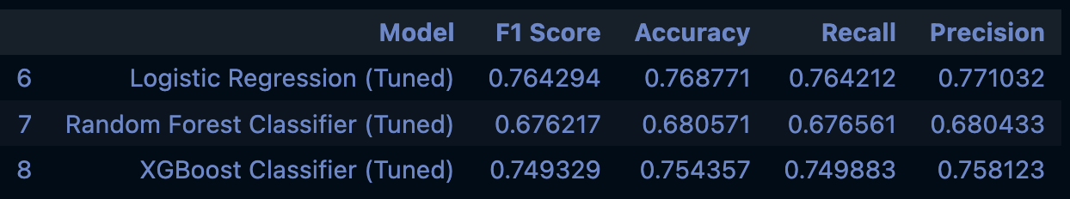
Model Training & Evaluation
Model | F1 Score
Logistic Regression | 0.7642
Random Forest Classifier | 0.6762
XGBoost Classifier | 0.7493

Slide 7
Logistic Regression Model
Efficiency
0.7687
F1-Score: 0.7642
Interpretability & Regularization
Metric: Accuracy

Slide 8

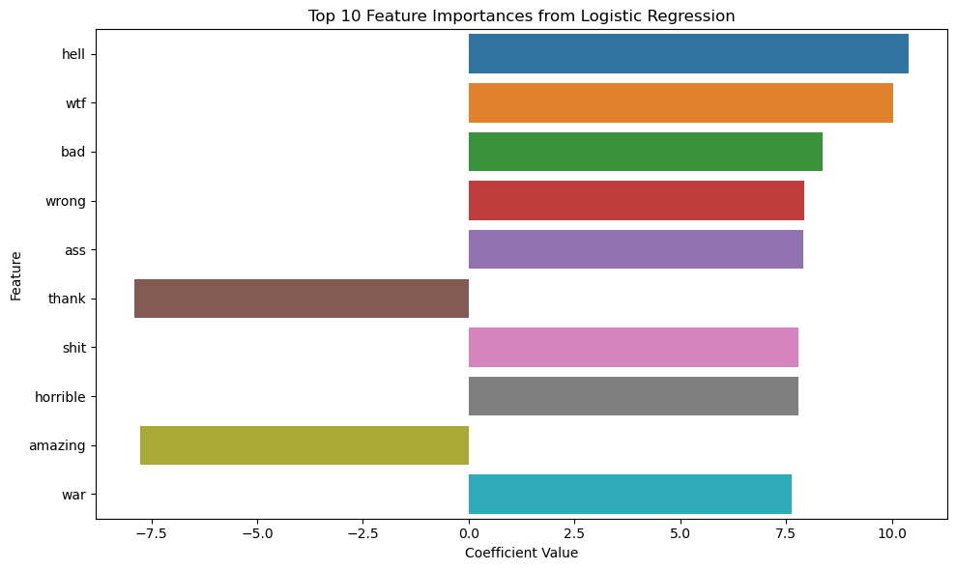
Model Interpretation

Slide 9

Analyzing Sentiment of Customer Support Interactions on X
Data Wrangling
Exploratory Data Analysis
Logistic Regression outperformed other models in all metrics.
Sentiment classification to mitigate churn rate.
Brands could personalize and improve CS – further research into automation.
Data Preprocessing
Training
Modeling
Deployment

Slide 10

Thanks!
Any questions?
You can find me at
Github Camilo Durango
camilodurangos@gmail.com
LinkedIn Camilo Durango

